Slide 1

7023T
Advanced Database Systems
Session 09
Designing and Developing ETL System
This presentation is based on Michael A. Fudge, Jr.

Slide 2
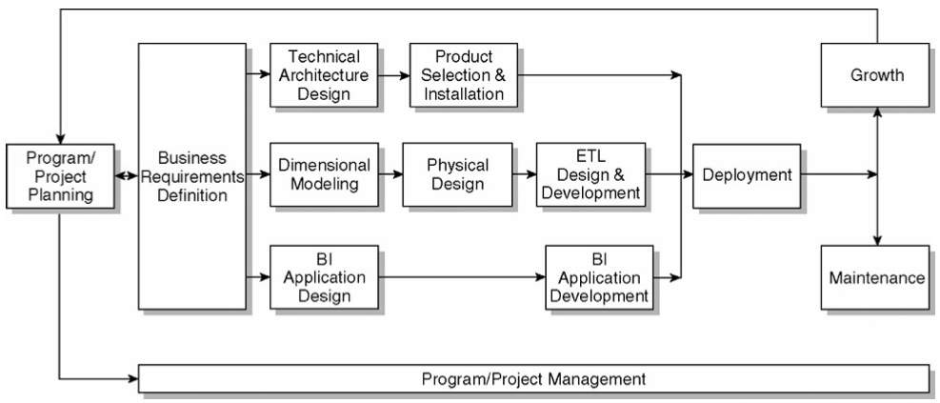
The Kimball Lifecycle Diagram

Slide 3
Before We Begin
We’ll need
Physical Design Star Schema implementation in ROLAP, with initial load.
Architecture Plan
Understanding of your DW/BI architecture.
Source to Target Mapping Part of the detailed design process.

Slide 4
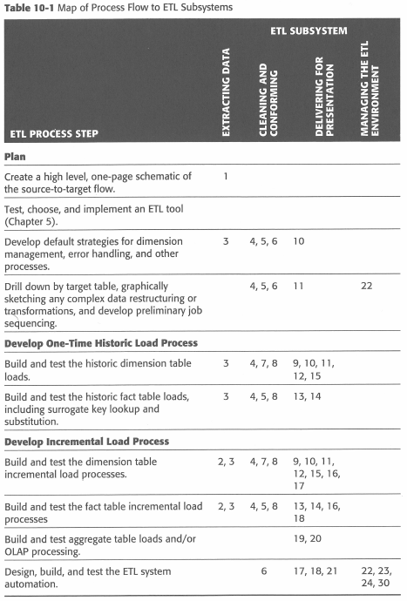
The Plan…
How the 34 subsystems map and are related to the 10 step plan.
According to Kimball.

Slide 5
Step 1: Draw The High Level Plan
This is called a source to target map.
Sources come from a variety of disparate areas.
Targets are Dimension and Fact Tables
Notes:
The boxes often represent a logical grouping of tables in the transaction system model.
As you develop the detailed ETL system specification, this high level view will gather additional details

Slide 6
Step 2: Choose an ETL Tool
Your ETL tool is responsible for moving data from the various sources into the data warehouse.
Programming language vs. Graphical tool.
Programming ➔ Flexibility, Customizable
Graphical ➔ Self Documenting, Easy for beginners
The best solution is somewhere in the middle.
Notes:
If your source systems are relational, your transformation requirements are straightforward, and you have good developers on staff, the value of an ETL tool may not be immediately obvious

Slide 7
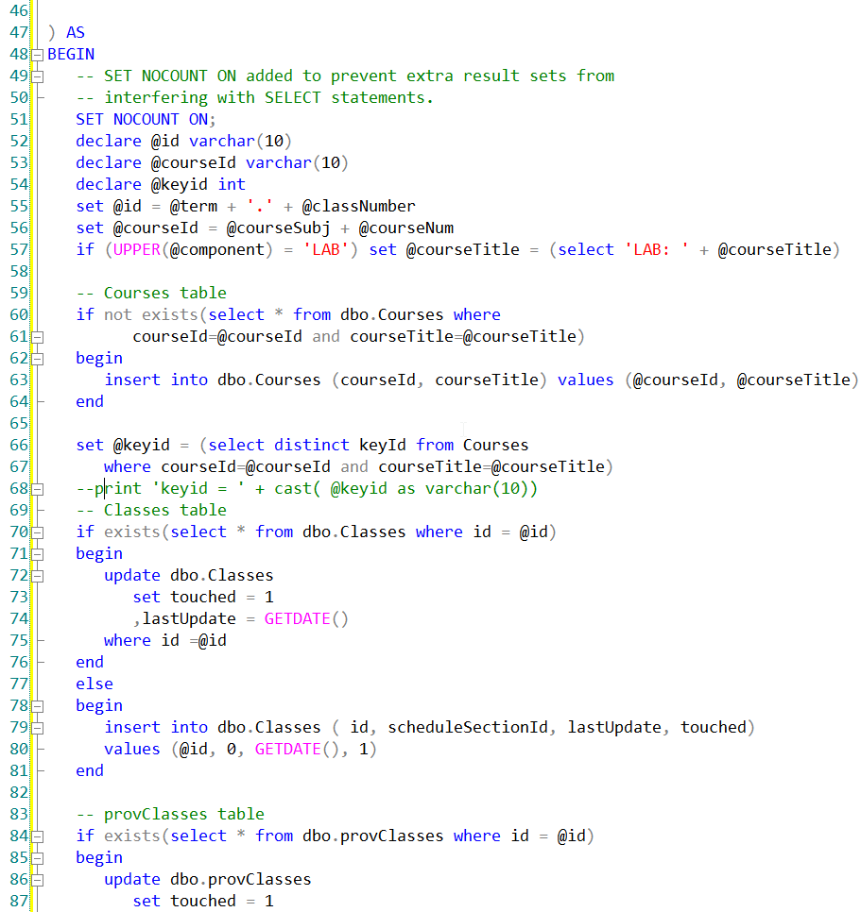
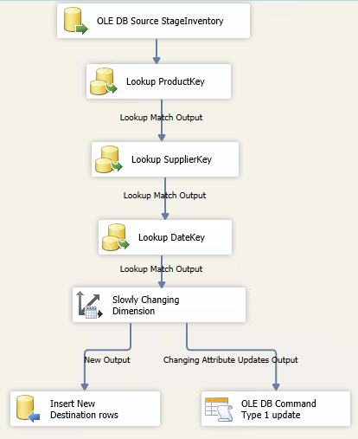
ETL: Code vs Tool
Which of these is easier to understand?

Slide 8





Why ETL Tools?
Self-documentation that comes from using a graphical tool
ETL tools offer advanced transformation logic: fuzzy matching algorithms, integrated access to name and address deduplication routines, and data mining algorithms
Improved system performance at a lower level of expertise.
Notes:
We recommend selecting an
ETL tool early on and using it right from the start. In a production system, the longterm improvements in manageability, productivity, and training are significant

Slide 9
Step 3: Develop Detailed Strategies
Data Extraction¹ & Archival² of Extracted Data
Data quality³ checks on dimensions & facts
Manage changes to dimensions⁴
Ensure the DW and ETL meet systems availability requirements
Design a data auditing subsystem
Organize the ETL staging area
Notes:
Push from the source system to a flat file, extract in a stream, use a tool to read the database logs, or another method?
The purpose of the archive is system auditability and recoverability
Develop a general, standardized process for how you will check data quality, and what you will do if the data does not pass quality control
Type 1 (overwrite history) or type 2 (track history)
Document when each data source becomes available, and block out high level job sequencing

Slide 10
The Role of the Staging
Staging stores copies of source extracts
This can be a Database or File Systems
Reduces unnecessary processing of data source.

Slide 11
Step 4: Drill Down by Target Table
Start drilling down into the detailed source to target flow for each target dimension and fact table
Flowcharts and pseudo code are useful for building out your transformation logic
ETL Tools allow you to build and document the data flow at the same time
Notes:
Develop Detailed Table Schematics
Develop the ETL Specification Document
Develop a Sandbox Source System: protects "live" servers and their data
Develop One-Time Historic Load Processing: initial historic load

Slide 12
Step 5: Populate Dimensions with Historic Data
Part of the one-time historic processing step.
Start with the simplest dimension table (usually type 1 SCD’s)
Transformations
Convert data ex. EBCDIC ←→ ASCII¹
Combine from separate sources ex. Customer information
Decode production codes ex. TTT→ Track-Type Tractor²
Validate Many-to-One and One-to-One Relationships ex: Category → Product³
Assign Surrogate Keys to Dimension table
Notes:
Extended Binary Coded Decimal Interchange Code (EBCDIC) is an 8-bit character encoding used mainly on IBM mainframe and IBM midrange computer operating systems. ASCII is 7 bit encoding
It often makes sense to create a rule to generate a dummy label that can easily be updated later. For example, you can create a dummy label: "Production Code ABC: No description available." When the description does eventually flow into the system, it is easy to update the string.
You can verify a many-to-one relationship between two attributes such as product to product model, by sorting on the "many" attribute and verifying that each value has a unique value on the "one" attribute

Slide 13
Step 6: Perform the Fact Table Historic Load
Part of the one-time historic processing step.
Transformations:
Replace special codes (eg. -1) with NULL on additive and semi- additive facts (for data that comes from a legacy system)
Calculate and store complex derived facts ex: shipping amount is divided among the number of items on the order.
Pivot rows into columns ex: amount type in financial schema, amount → budget, actual, or forecast
Pipeline the Dimension Surrogate Key Lookup
Associate with Audit Dimension¹
Notes:
The one-time historic load of the fact table data differs fairly significantly from the ongoing incremental processing. The biggest worry during the historic load is the sheer volume of data, often thousands of times bigger than the daily incremental load.
1) The audit key points to an audit dimension that describes
the characteristics of the load, including timings and measures of data quality

Slide 14
Example Surrogate Key Pipeline
Handles SCD’s

Slide 15
Step 7: Dimension Table Incremental Processing
Oftentimes the same logic used in the Historic load can be used.
Identify New/Changed data based on different attributes for the same natural key
ETL tools usually can assist with this logic.
CDC (Change Data Capture) Systems are popular

Slide 16
Step 8: Fact Table Incremental Processing
A complex ETL:
Can be difficult to determine which facts need to be processed?
What happens to a fact when it is re-processed?
What if a dimension key lookup fails?
Some ETL tool assist with processing this logic.
Degenerate dimensions can be used ex: transaction number in order summary
A combination of dimension keys ex: StudentKey and ClassKey for grade processing.
CDC (Change Data Capture) Systems are popular

Slide 17
CDC - Change Data Capture
Data Change Events (Create, Update, Delete) are passed to the CDC System
The system acts as a source for the ETL Process
Database Transaction Log
OLTP
CDC
System
ETL Job
OR
Msg Queue / Service Bus

Slide 18
Step 9: Aggregate Table and OLAP Loads
Further processing beyond the ROLAP star schema.
Most ROLAPS Exist to feed the MOLAP Databases
Refresh / Reprocess
MOLAP cubes
INDEXED / MATERIALIZED views
Aggregate summary tables

Slide 19
Step 10: ETL System Operation & Automation
Schedule jobs
Catch and Log errors / exceptions
Database management tasks:
Cleanup old data
Shrink Database
Rebuild indexes
Update Statistics

